Slide 1
Single-Area OSPF Implementation
Implementing OSPF

Slide 2
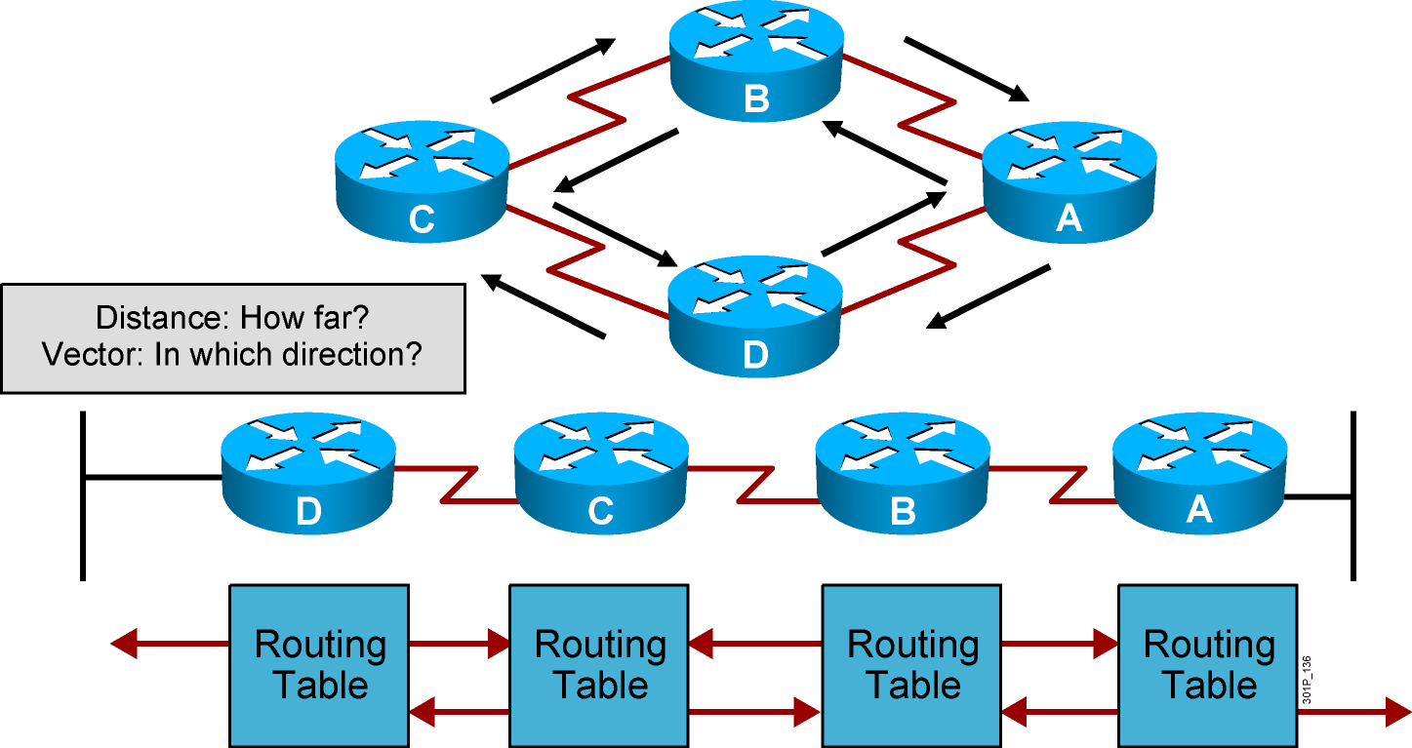
Distance Vector Routing Protocols
Passes periodic copies of routing table to neighbor routes and accumulates distance vectors
Notes:
Lesson Aim
<Enter lesson aim here.>

Slide 3
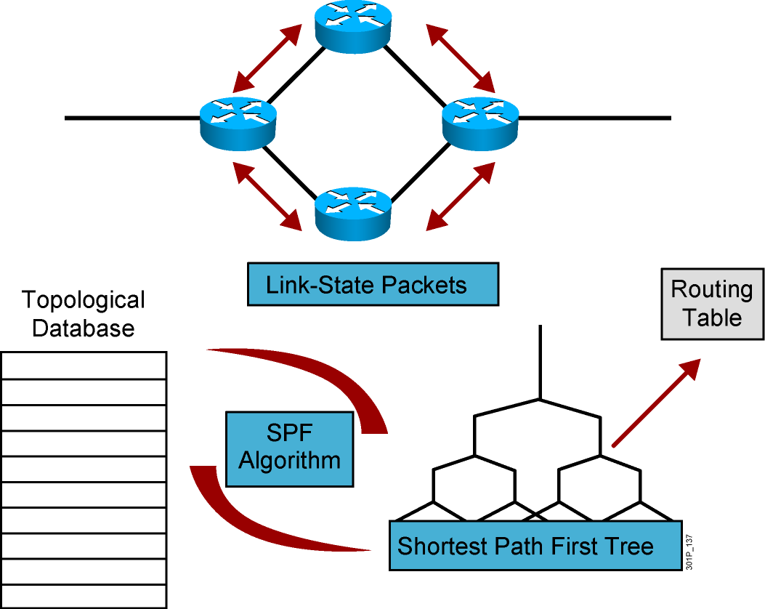
Link-State Routing Protocols
After initial flood, passes small event-triggered link-state updates to all other routers
Notes:
Lesson Aim
<Enter lesson aim here.>

Slide 4
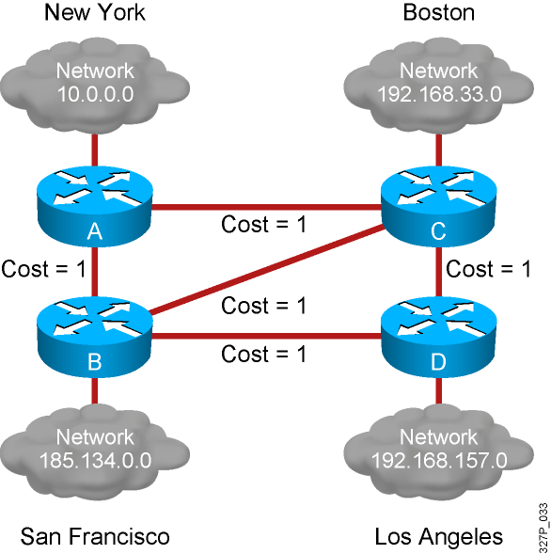
Link-State Routing Protocol Algorithms

Slide 5
Benefits and Drawbacks of Link-State Routing
  Benefits of link-state routing:
    Fast convergence:
      Changes are reported immediately by the affected source
    Robustness against routing loops:
      Routers know the topology
      Link-state packets are sequenced and acknowledged
    Hierarchical network design enables optimization of resources.
  Drawbacks of link-state routing:
    Significant demands for resources:
      Memory (three tables: adjacency, topology, forwarding)
      CPU (Dijkstra’s algorithm can be intensive, especially when there are many instabilities)
    Requires very strict network design
    Configuration can be complex when tuning various parameters and when design is complex

Slide 6
OSPF Overview
  Creates a neighbor relationship by exchanging hello packets
  Propagates LSAs rather than routing table updates
    Link: Router interface
    State: Description of an interface and its relationship to neighboring routers
  Floods LSAs to all OSPF routers in the area, not just directly connected routers
  Pieces together all the LSAs generated by the OSPF routers to create the OSPF link-state database
  Uses the SPF algorithm to calculate the shortest path to each destination and places it in the routing table
Notes:
Purpose: This figure presents the IGRP metric with its five possible components.
Emphasize : Bandwidth and delay are the two metrics that are most commonly used. They also comprise the default metric.
Note: Changing IGRP metrics can have great impact on network performance.
Describe the IGRP 24-bit metric field, as follows:
Bandwidth—Minimum bandwidth on the route, in kilobits per second.
Delay—Route delay, in tens of microseconds.
Reliability—Likelihood of successful packet transmission, expressed as an integer from 0 to 255.
Loading—Effective bandwidth of path.
MTU—Minimum MTU in path, expressed in bytes.
The following equation calculates the metric. It is presented for instructors and is not required to be taught:
metric = [k1 x bandwidth + (k2 x bandwidth) / (256 - load) + k3 x delay]
If k5 does not equal 0, an additional operation is done:
metric = metric x (k5/(reliability + k4))
The default constant values are k1 = k3 = 1 and k2 = k4 = k5 = 0.
Again, if default values are set, metric = bandwidth + delay.
The constants (k1, k2, k3) can be changed using the metric weights command. Changes to the IGRP constant values should be made with great care.

Slide 7
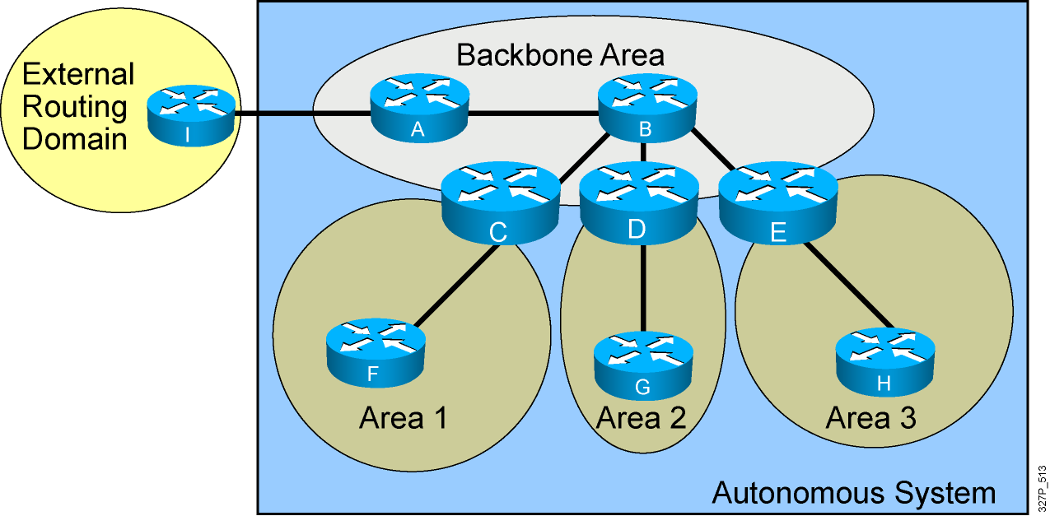
OSPF Hierarchy Example
Minimizes routing table entries
Localizes the impact of a topology change within an area
Notes:
Summarizing is the consolidation of multiple routes into one single advertisement. Proper summarization requires contiguous addressing.
Route summarization directly affects the amount of bandwidth, CPU, and memory resources consumed by the OSPF process. With summarization, if a network link fails, the topology change will not be propagated into the backbone (and other areas by way of the backbone). As such, flooding outside the area will not occur, so routers outside of the area with the topology change will not have to run the SPF algorithm (also called the Dijkstra algorithm after the computer scientist who invented it). Running the SPF algorithm is a CPU-intensive activity.
There are two types of summarization:
Interarea route summarization—Interarea route summarization is done on ABRs and applies to routes from within the autonomous system. It does not apply to external routes injected into OSPF via redistribution. In order to take advantage of summarization, network numbers in areas should be assigned in a contiguous way so as to be able to consolidate these addresses into one range. This graphic illustrates interarea summarization.
External route summarization—External route summarization is specific to external routes that are injected into OSPF via redistribution. Here again, it is important to ensure that external address ranges that are being summarized are contiguous. Summarization overlapping ranges from two different routers could cause packets to be sent to the wrong destination.

Slide 8
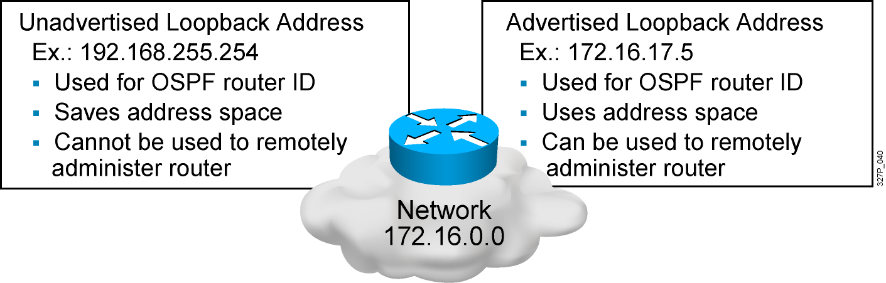
Configuring Loopback Interfaces
Router ID:
  Number by which the router is known to OSPF
  Default: The highest IP address on an active interface at the moment of OSPF process startup
  Can be overridden by a loopback interface: Highest IP address of any active loopback interface
  Can be set manually using the router-id command

Slide 9
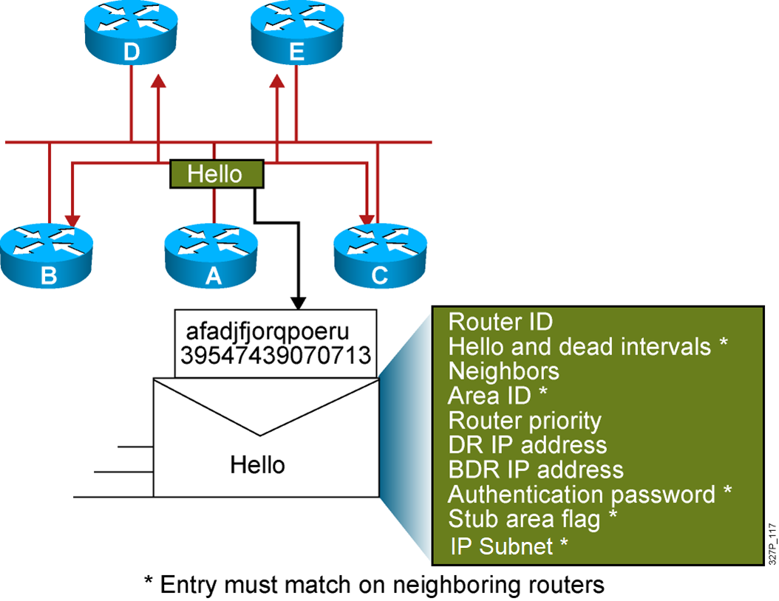
Neighbor Adjacencies: The Hello Packet

Slide 10
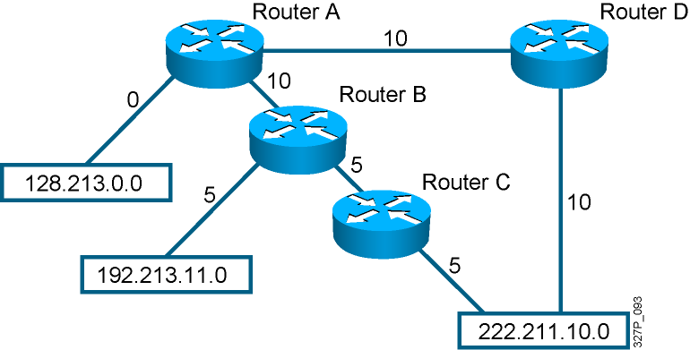
SPF Algorithm
10
10
1
1
1
  Places each router at the root of a tree and calculates the
  shortest path to each destination based on the cumulative cost
  Cost = Reference Bandwidth / Interface Bandwidth (b/s)
Notes:
Purpose: The figure presents how IGRP load sharing improves throughput and increases reliability.
Emphasize: Only feasible paths can be used for IGRP load sharing.
Load-balancing methods vary according to the switching mode because the data structures for process switching, fast switching, and autonomous switching are all different. When process switching, the processor load-balances packet by packet. When fast, autonomous, or silicon switching, load balancing is done destination by destination.
By default, the amount of variance is set to one, which results in equal-cost load balancing.
You can use the default-metric command to change the default metric.
Transition: The following pages describe how to configure the IGRP routing protocol.

Slide 11
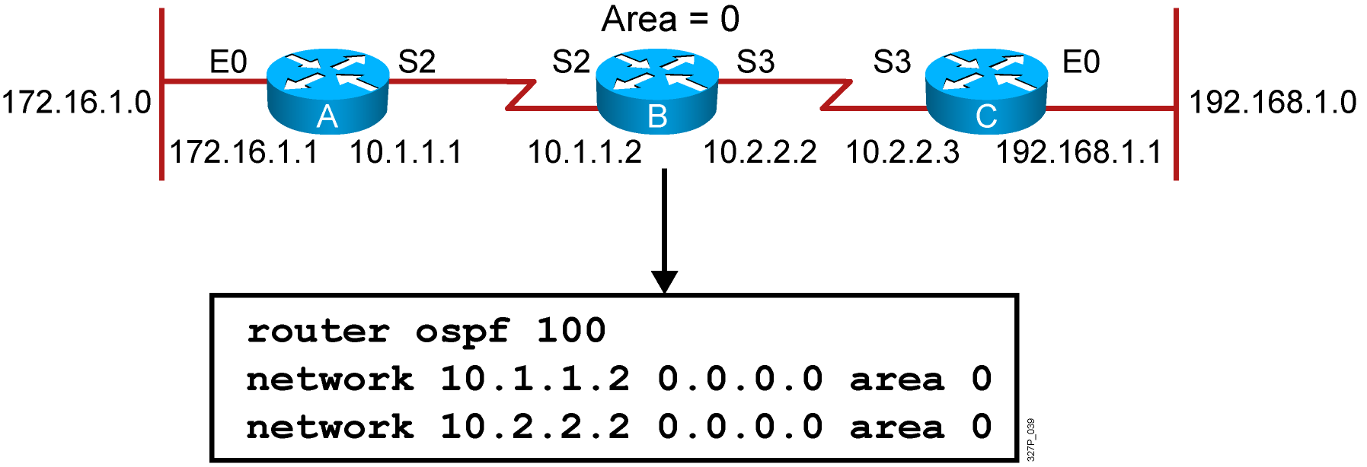
Configuring Single-Area OSPF
RouterX(config)# router ospf process-id
Defines OSPF as the IP routing protocol
RouterX(config-router)# network address wildcard-mask area area-id
Assigns networks to a specific OSPF area
Notes:
Slide 1 of 2
Purpose: This figure explains how to use the router igrp and network commands to configure an IGRP process.
Emphasize: Note that the AS keyword is required for IGRP.
You can use multiple network commands to specify all networks that are to participate in the IGRP process. Only those networks specified will be published to other routers.

Slide 12
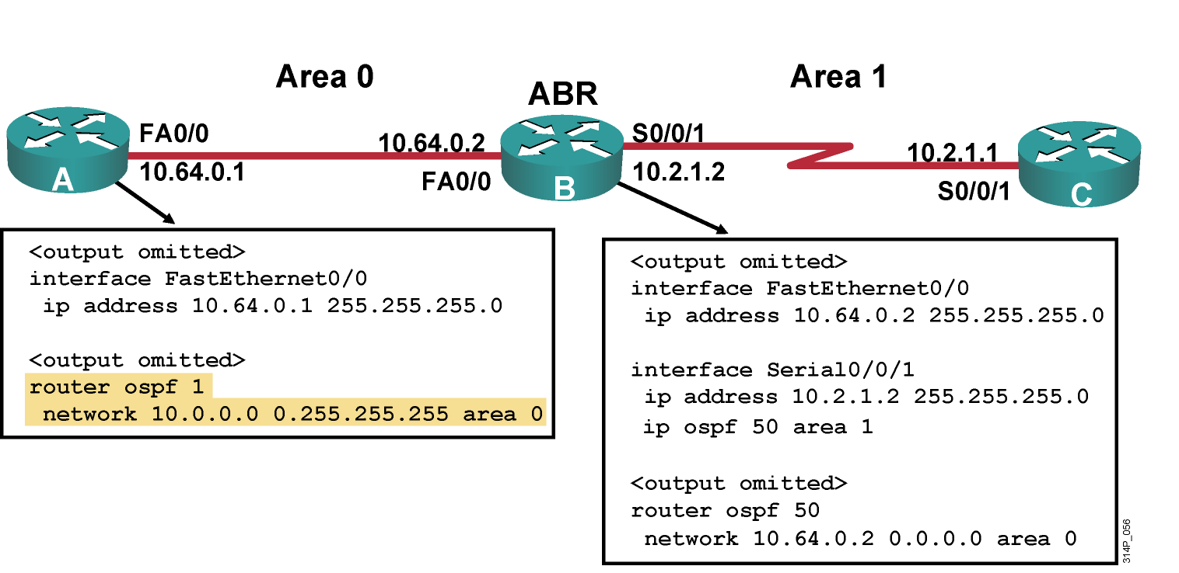
Configuring OSPF for Multiple Areas

Slide 13
Load Balancing with OSPF
OSPF load balancing:
  Paths must be equal cost
  By default, up to four equal-cost paths can be placed into the routing table
  With a configuration change, up to a maximum of 16 paths can be configured:
    (config-router)# maximum-paths <value>
  To ensure paths are equal cost for load balancing, you can change the cost of a particular link:
    (config-if)# ip ospf cost <value>

Slide 14
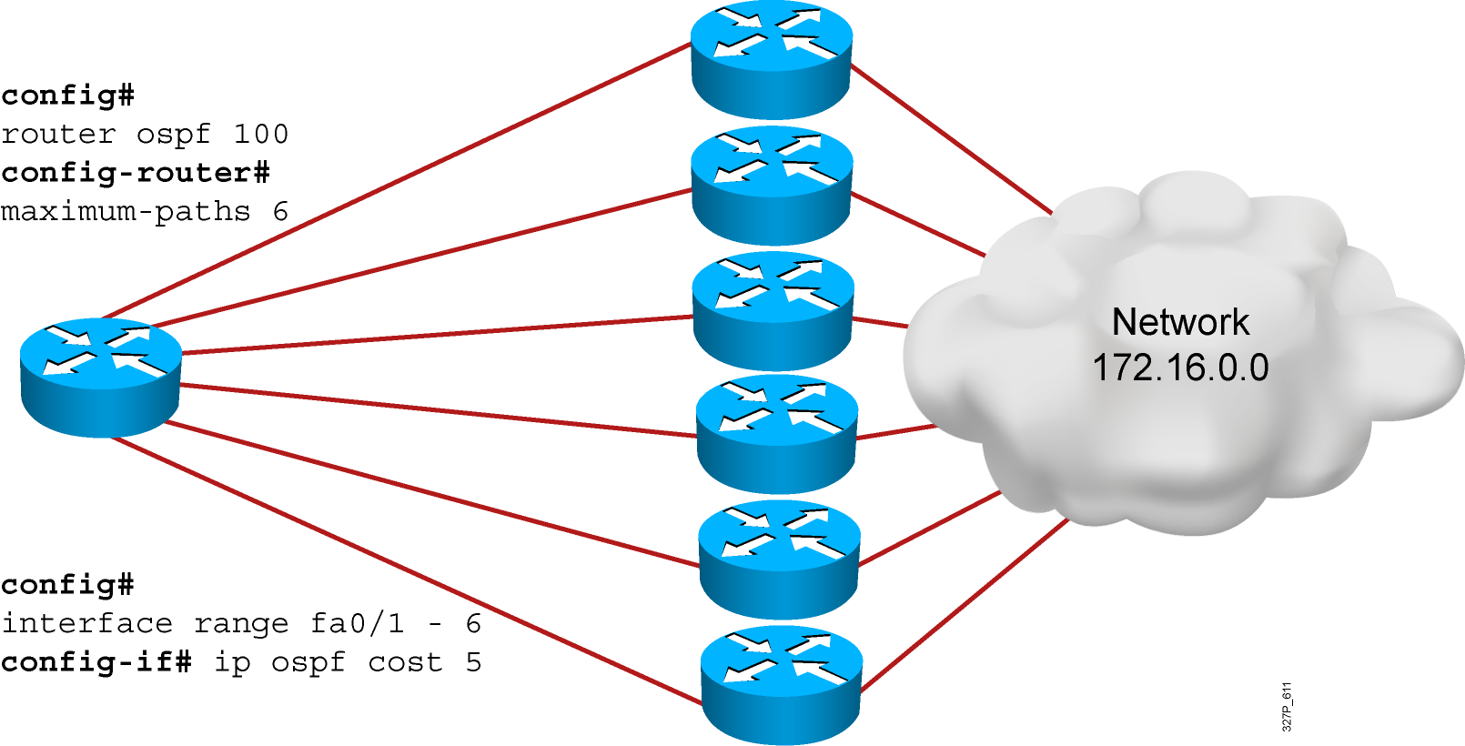
Load Balancing with OSPF

Slide 15
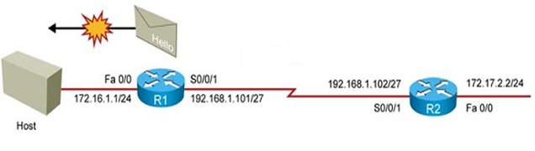
Using passive-interface command
No need to talk to host by OSPF
Disables OSPF on selected interfaces.
Still advertise subnet on the selected interfaces.

Slide 16
Verifying the OSPF Configuration
RouterX# show ip protocols
Verifies that OSPF is configured
RouterX# show ip route
Displays all the routes learned by the router
RouterX# show ip route
Codes: I - IGRP derived, R - RIP derived, O - OSPF derived,
C - connected, S - static, E - EGP derived, B - BGP derived,
E2 - OSPF external type 2 route, N1 - OSPF NSSA external type 1 route,
N2 - OSPF NSSA external type 2 route
Gateway of last resort is 10.119.254.240 to network 10.140.0.0
O 10.110.0.0 [110/5] via 10.119.254.6, 0:01:00, Ethernet2
O IA 10.67.10.0 [110/10] via 10.119.254.244, 0:02:22, Ethernet2
O 10.68.132.0 [110/5] via 10.119.254.6, 0:00:59, Ethernet2
O 10.130.0.0 [110/5] via 10.119.254.6, 0:00:59, Ethernet2
O E2 10.128.0.0 [170/10] via 10.119.254.244, 0:02:22, Ethernet2
. . .
Notes:
240, 197, 102

Slide 17
Verifying the OSPF Configuration (Cont.)
RouterX# show ip ospf
Displays the OSPF router ID, timers, and statistics
RouterX# show ip ospf
Routing Process "ospf 50" with ID 10.64.0.2
<output omitted>
Number of areas in this router is 1. 1 normal 0 stub 0 nssa
Number of areas transit capable is 0
External flood list length 0
Area BACKBONE(0)
Area BACKBONE(0)
Area has no authentication
SPF algorithm last executed 00:01:25.028 ago
SPF algorithm executed 7 times
<output omitted>

Slide 18
Verifying the OSPF Configuration (Cont.)
RouterX# show ip ospf interface
Displays the area ID and adjacency information
RouterX# show ip ospf interface ethernet 0
Ethernet 0 is up, line protocol is up
Internet Address 192.168.254.202, Mask 255.255.255.0, Area 0.0.0.0
AS 201, Router ID 192.168.99.1, Network Type BROADCAST, Cost: 10
Transmit Delay is 1 sec, State OTHER, Priority 1
Designated Router id 192.168.254.10, Interface address 192.168.254.10
Backup Designated router id 192.168.254.28, Interface addr 192.168.254.28
Timer intervals configured, Hello 10, Dead 60, Wait 40, Retransmit 5
Hello due in 0:00:05
Neighbor Count is 8, Adjacent neighbor count is 2
Adjacent with neighbor 192.168.254.28 (Backup Designated Router)
Adjacent with neighbor 192.168.254.10 (Designated Router)

Slide 19
Verifying the OSPF Configuration (Cont.)
RouterX# show ip ospf neighbor
Displays the OSPF neighbor information on a per-interface basis
RouterX# show ip ospf neighbor
ID Pri State Dead Time Address Interface
10.199.199.137 1 FULL/DR 0:00:31 192.168.80.37 FastEthernet0/0
172.16.48.1 1 FULL/DROTHER 0:00:33 172.16.48.1 FastEthernet0/1
172.16.48.200 1 FULL/DROTHER 0:00:33 172.16.48.200 FastEthernet0/1
10.199.199.137 5 FULL/DR 0:00:33 172.16.48.189 FastEthernet0/1

Slide 20
Verifying the OSPF Configuration (Cont.)
RouterX# show ip ospf neighbor 10.199.199.137
Neighbor 10.199.199.137, interface address 192.168.80.37
In the area 0.0.0.0 via interface Ethernet0
Neighbor priority is 1, State is FULL
Options 2
Dead timer due in 0:00:32
Link State retransmission due in 0:00:04
Neighbor 10.199.199.137, interface address 172.16.48.189
In the area 0.0.0.0 via interface Fddi0
Neighbor priority is 5, State is FULL
Options 2
Dead timer due in 0:00:32
Link State retransmission due in 0:00:03

Slide 21
OSPF debug Commands
RouterX# debug ip ospf events
OSPF:hello with invalid timers on interface Ethernet0
hello interval received 10 configured 10
net mask received 255.255.255.0 configured 255.255.255.0
dead interval received 40 configured 30
OSPF: rcv. v:2 t:1 l:48 rid:200.0.0.117
aid:0.0.0.0 chk:6AB2 aut:0 auk:
RouterX# debug ip ospf packet
OSPF: rcv. v:2 t:1 l:48 rid:200.0.0.116
aid:0.0.0.0 chk:0 aut:2 keyid:1 seq:0x0

Slide 22
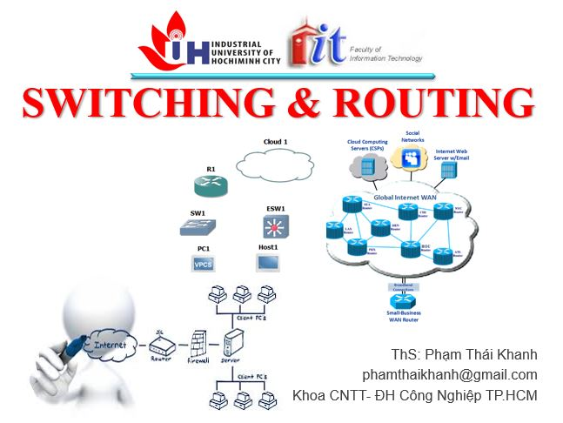


phamthaikhanh@gmail.com
This Photo by Unknown Author is licensed under CC BY-NC

